Slide 1


CE251: Java PROGRAMMING
July – November 2021
Chapter – 3
Inheritance, Interfaces & Packages
By: Prof. Ritika Jani
IT-DEPSTAR

Slide 2
Inheritance
Inheritance in Java is a mechanism in which one object acquires all the properties and behaviors of a parent object.
The idea behind inheritance in Java is that you can create new classes that are built upon existing classes. When you inherit from an existing class, you can reuse methods and fields of the parent class. Moreover, you can add new methods and fields in your current class also.
Inheritance represents the IS-A relationship which is also known as a parent-child relationship.

Slide 3
Why use inheritance in java
For Method Overriding
For Code Reusability.

Slide 4
Terms used in Inheritance
Class
Sub class
Super class
Reusability

Slide 5
Syntax of inheritance
Class sub-class extends super-class
{
// code
}
The extends keyword indicates that you are making a new class that derives
from an existing class. The meaning of "extends" is to increase the functionality.

Slide 6
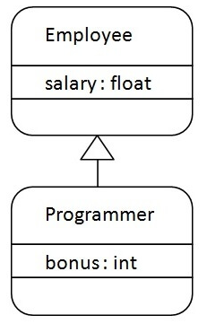
Inheritance Example
class Employee{
float salary=40000;
}
class Programmer extends Employee{
int bonus=10000;
public static void main(String args[]){
Programmer p=new Programmer();
System.out.println("Programmer salary is:"+p.salary);
System.out.println("Bonus of Programmer is:"+p.bonus);
}
}

Slide 7
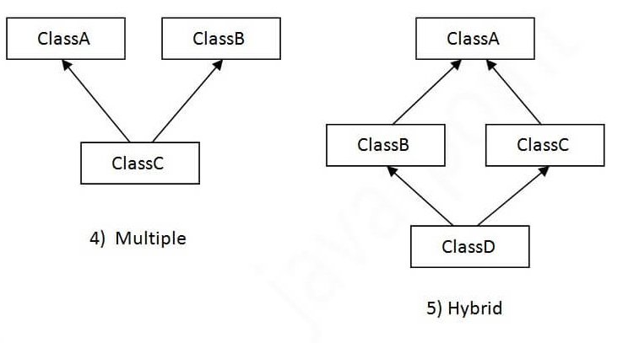
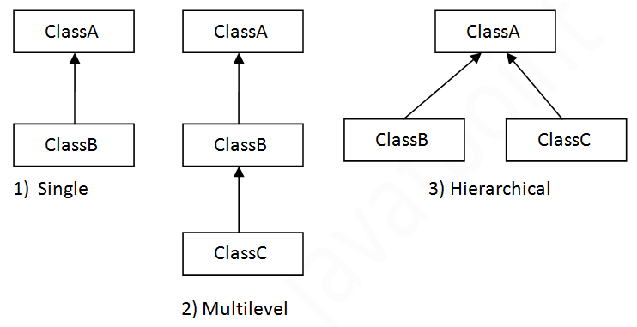
Types of inheritance in java
On the basis of class, there can be three types of inheritance in java: single, multilevel and hierarchical.
In java programming, multiple and hybrid inheritance is supported through interface only.

Slide 8
Single Inheritance Example
class Animal
{
void eat()
{System.out.println("eating...");}
}
class Dog extends Animal{
void bark(){System.out.println("barking...");}
}
class TestInheritance{
public static void main(String args[]){
Dog d=new Dog();
d.bark();
d.eat();
}}

Slide 9
Multilevel Inheritance Example
class Animal
{
void eat(){System.out.println("eating...");}
}
class Dog extends Animal{
void bark(){System.out.println("barking...");}
}
class BabyDog extends Dog{
void weep(){System.out.println("weeping...");}
}
class TestInheritance2{
public static void main(String args[]){
BabyDog d=new BabyDog();
d.weep();
d.bark();
d.eat();
}}

Slide 10
Hierarchical Inheritance Example
class Animal{
void eat(){System.out.println("eating...");}
}
class Dog extends Animal{
void bark(){System.out.println("barking...");}
}
class Cat extends Animal{
void meow(){System.out.println("meowing...");}
}
class TestInheritance3{
public static void main(String args[]){
Cat c=new Cat();
c.meow();
c.eat();
//c.bark();//C.T.Error
}}

Slide 11
Why multiple inheritance is not supported in java?

Slide 12
class A
{
void msg()
{
System.out.println("Hello");}
}
class B{
void msg()
{
System.out.println("Welcome");}
}
class C extends A,B{//suppose if it were
public static void main(String args[]){
C obj=new C();
obj.msg();//Now which msg() method would be invoked?
}
}
Output:
Compile time error

Slide 13
Super Keyword in java
refer immediate parent class instance variable.
invoke immediate parent class method.
invoke immediate parent class constructor.

Slide 14
Refer immediate parent class instance variable.
class Animal
{
String color="white";
}
class Dog extends Animal{
String color="black";
void printColor(){
System.out.println(color);
System.out.println(super.color);
}
}
class TestSuper1{
public static void main(String args[]){
Dog d=new Dog();
d.printColor();
}}
Output:
Black
white

Slide 15
To invoke parent class method
class Animal
{
void eat()
{System.out.println("eating...");}
}
class Dog extends Animal{
void eat(){System.out.println("eating bread...");}
void bark(){System.out.println("barking...");}
void work(){
super.eat();
bark();
}
}
class TestSuper2{
public static void main(String args[]){
Dog d=new Dog();
d.work();
}}
Output:
eating…
barking…

Slide 16
To invoke parent class constructor.
class Animal{
Animal(){System.out.println("animal is created");}
}
class Dog extends Animal{
Dog(){
super();
System.out.println("dog is created");
}
}
class TestSuper3{
public static void main(String args[]){
Dog d=new Dog();
}}
Output:
Animal is created
Dog is created

Slide 17
Method Overriding in Java
If subclass (child class) has the same method as declared in the parent class, it is known as method overriding in Java.

Slide 18
Usage of Java Method Overriding
to provide the specific implementation of a method which is already provided by its superclass.
To provide runtime polymorphism

Slide 19
Rules for Java Method Overriding
The method must have the same name as in the parent class
The method must have the same parameter as in the parent class.
There must be an IS-A relationship (inheritance).

Slide 20
What is the output of following program
class Vehicle{
void run()
{
System.out.println("Vehicle is running");}
}
class Bike extends Vehicle
{
public static void main(String args[])
{
Bike obj = new Bike();
obj.run();
}
}
Output:
Vehicle is running
Problem is that I have to provide a specific implementation
of run() method in subclass that is why we use method overriding.

Slide 21
class Vehicle
{
void run(){System.out.println("Vehicle is running");}
}
class Bike2 extends Vehicle{
void run(){System.out.println("Bike is running safely");}
public static void main(String args[]){
Bike2 obj = new Bike2();//creating object
obj.run();//calling method
}
}

Slide 22
Method overriding using the super Keyword
class Animal {
public void move() {
System.out.println("Animals can move");
}
}
class Dog extends Animal {
public void move() {
super.move();
System.out.println("Dogs can walk and run");
}
}
public class TestDog
{
public static void main(String args[]) {
Animal b = new Dog(); // Animal reference but Dog object
b.move(); // runs the method in Dog class
}
}
Output:
Animals can Move
Dogs can walk and run

Slide 23
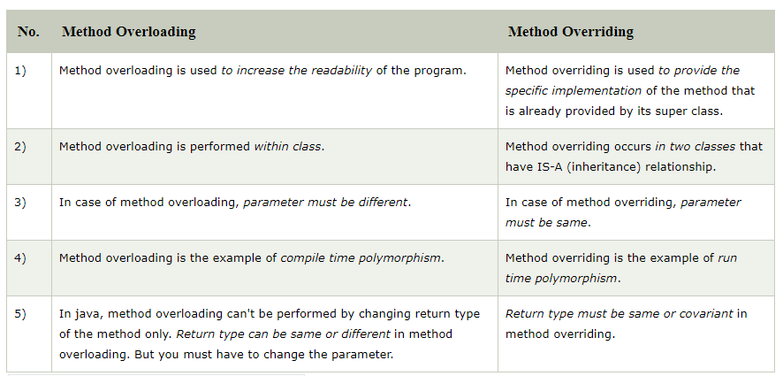
Difference between method overriding and overloading

Slide 24
Can we override static method?
No, a static method cannot be overridden. It can be proved by runtime polymorphism.

Slide 25
Why can we not override static method?
it is because the static method is bound with class whereas instance method is bound with an object. Static belongs to the class area, and an instance belongs to the heap area.

Slide 26
Can static members inherited to sub classes in Java?
Yes, Static members can inherited to sub classes.

Slide 27
Can we override java main method?
No
because the main is a static method.

Slide 28
Can a final method be overridden?
NO

Slide 29
What happens if both superclass and subclass have a field with the same name?
Only subclass members are accessible if an object of subclass is instantiated.

Slide 30
Is interface inherited from the Object class?
NO

Slide 31
Can a Class Extend Itself in Java?
NO

Slide 32
A class member declared protected becomes member of subclass of which type?
A class member declared protected becomes private member of subclass.

Slide 33
Dynamic method dispatch

Slide 34
Dynamic Method Dispatch
It is also known as runtime polymorphism
Dynamic method dispatch is the mechanism in which a call to an overridden method is resolved at run time instead of compile time.
Java uses the principle of ‘a superclass reference variable can refer to a subclass object’ to resolve calls to overridden methods at run time.
When a superclass reference is used to call an overridden method, Java determines which version of the method to execute based on the type of the object being referred to at the time call.

Slide 35
class A
{
void m1()
{System.out.println("Inside A's m1 method");
}
}
class B extends A
{
void m1()
{System.out.println("Inside B's m1 method");
}
}
class C extends A
{ void m1()
{System.out.println("Inside C's m1 method");
}
}
class Dispatch
{
public static void main(String args[])
{
A a = new A();
B b = new B();
C c = new C();
A ref;
ref = a;
ref.m1();
ref = b;
ref.m1();
ref = c;
ref.m1();
}}
Output:
Inside A's m1 method
Inside B's m1 method
Inside C's m1 method

Slide 36
Final Keyword with class
If you make any class as final, you cannot extend it.

Slide 37
final class Bike{}
class Honda1 extends Bike{
void run(){System.out.println("running safely with 100kmph");}
public static void main(String args[]){
Honda1 honda= new Honda1();
honda.run();
}
}
Output:
Compile time error

Slide 38
Is final method inherited?
Yes

Slide 39
Abstract class in Java

Slide 40
Abstract class in Java
A class which is declared with the abstract keyword is known as an abstract class in Java. It can have abstract and non-abstract methods (method with the body).
Abstraction is a process of hiding the implementation details and showing only functionality to the user.
It needs to be extended and its method implemented. It cannot be instantiated.
Abstraction lets you focus on what the object does instead of how it does it.

Slide 41
Ways to archive abstraction
Abstract class
Interface

Slide 42
Points to Remember
An abstract class must be declared with an abstract keyword.
It can have abstract and non-abstract methods.
It cannot be instantiated.
It can have constructors and static methods also.
It can have final methods which will force the subclass not to change the body of the method.

Slide 43
abstract class Bike
{
abstract void run();
}
class Honda4 extends Bike{
void run(){System.out.println("running safely");}
public static void main(String args[]){
Bike obj = new Honda4();
obj.run();
}
}
Output:
Running safely

Slide 44
Abstract class having constructor, data member and methods
abstract class Bike{
Bike(){System.out.println("bike is created");}
abstract void run();
void changeGear(){System.out.println("gear changed");}
}
class Honda extends Bike{
void run(){System.out.println("running safely..");}
}
class TestAbstraction2{
public static void main(String args[]){
Bike obj = new Honda();
obj.run();
obj.changeGear();
}
}
Output:
Bike is created
Running safely..
Gear changed

Slide 45
Java Package

Slide 46
Java Package
A java package is a group of similar types of classes, interfaces and sub-packages.
Package in java can be categorized in two form, built-in package and user-defined package.
There are many built-in packages such as java, lang, awt, javax, swing, net, io, util, sql etc.

Slide 47
Use of Package
Preventing naming conflicts.
For example there can be two classes with name Employee in two packages, CHARUSAT.staff.cse.Employee and CHARUSAT.staff.ee.Employee
Making searching/locating and usage of classes, interfaces, enumerations and annotations easier
Packages can be considered as data encapsulation (or data-hiding).

Slide 48
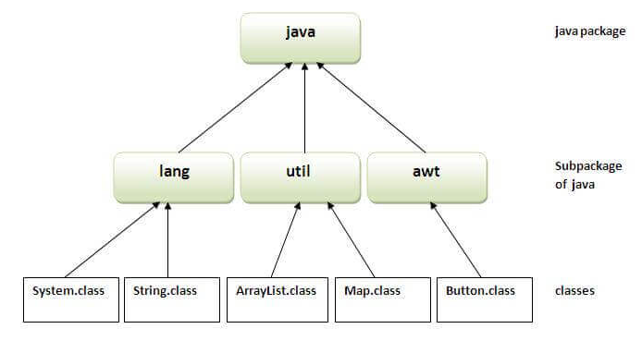
Advantage of Java Package
Java package is used to categorize the classes and interfaces so that they can be easily maintained.
Java package provides access protection.
Java package removes naming collision.
The package keyword is used to create a package in java.

Slide 49
How to compile and rub java package
Compile: Javac –d directory javafileName
Run : Java packName.javafileName

Slide 50
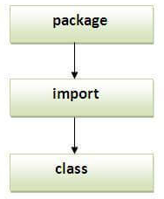
How to access package from another package?
import package.*;
import package.classname;
fully qualified name.

Slide 51
Using packagename.*
if you use package.* then all the classes and interfaces of this package will be accessible but not sub packages.
The import keyword is used to make the classes and interface of another package accessible to the current package.
//save by B.java
package mypack;
import pack.*;
class B{
public static void main(String args[]){
A obj = new A();
obj.msg();
}
}
//save by A.java
package pack;
public class A{
public void msg()
{
System.out.println("Hello");
}
}
Output:
Hello

Slide 52
Using packagename.classname
If we import package.classname then only declared class of this package will be accessible
//save by A.java
package pack;
public class A{
public void msg()
{
System.out.println("Hello");
}
}
//save by B.java
package mypack;
import pack.A;
class B{
public static void main(String args[])
{
A obj = new A();
obj.msg();
}
}
Output:
Hello

Slide 53
Using fully qualified name
if you use fully qualified name then only declared class of this package will be accessible. Now there is no need to import. But you need to use fully qualified name every time when you are accessing the class or interface.
It is generally used when two packages have same class name e.g. java.util and java.sql packages contain Date class.
//save by A.java
package pack;
public class A{
public void msg()
{
System.out.println("Hello");
}
}
//save by B.java
package mypack;
class B{
public static void main(String args[]){
pack.A obj = new pack.A();
obj.msg();
}
}

Slide 54
Sub package in java
Package inside the package is called the subpackage. It should be created to categorize the package further.
package com.CSPIT.core;
class Simple{
public static void main(String args[])
{
System.out.println("Hello subpackage");
}
}
To Compile: javac –d Simple.java
To Run: java.com.CSPIT.core.Simple

Slide 55
Package class
The package class provides methods to get information about the specification and implementation of a package. It provides methods such as getName(), getImplementationTitle(), getImplementationVendor(), getImplementationVersion() etc.

Slide 56
Interface in java

Slide 57
Interface in java
An interface in Java is a blueprint of a class. It has static constants and abstract methods.
The interface in Java is a mechanism to achieve abstraction. There can be only abstract methods in the Java interface, not method body. It is used to achieve abstraction and multiple inheritance in Java.
In other words, you can say that interfaces can have abstract methods and variables. It cannot have a method body.

Slide 58
Interface in java
Java Interface also represents the IS-A relationship.
It cannot be instantiated just like the abstract class.
Since Java 8, we can have default and static methods in an interface.
Since Java 9, we can have private methods in an interface.

Slide 59
Why use Java interface?
t is used to achieve abstraction.
By interface, we can support the functionality of multiple inheritance.
It can be used to achieve loose coupling.

Slide 60
How to declare an interface?
An interface is declared by using the interface keyword.
It provides total abstraction, means all the methods in an interface are declared with the empty body, and all the fields are public, static and final by default.
A class that implements an interface must implement all the methods declared in the interface.
Syntax:
interface <interface_name>
{
// declare constant fields
// declare methods that abstract
// by default.
}

Slide 61
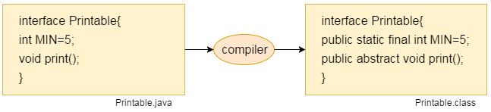
Internal addition by the compiler
The Java compiler adds public and abstract keywords before the interface method. Moreover, it adds public, static and final keywords before data members.

Slide 62
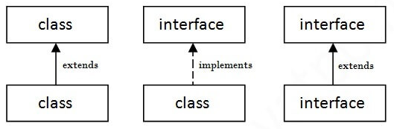
The relationship between classes and interfaces

Slide 63
Java Interface Example
interface printable{
void print();
}
class A6 implements printable{
public void print(){System.out.println("Hello");}
public static void main(String args[]){
A6 obj = new A6();
obj.print();
}
}
Output:
Hello

Slide 64
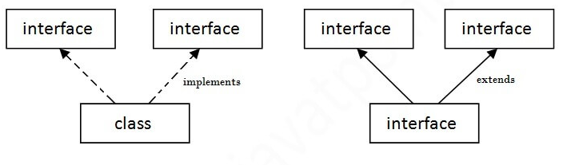
Multiple inheritance in Java by interface
If a class implements multiple interfaces, or an interface extends multiple interfaces, it is known as multiple inheritance.

Slide 65
Multiple inheritance is not supported through class in java, but it is possible by an interface, why?
it is supported in case of an interface because there is no ambiguity.

Slide 66
interface Printable{
void print();
}
interface Showable{
void print();
}
class TestInterface3 implements Printable, Showable{
public void print(){System.out.println("Hello");}
public static void main(String args[]){
TestInterface3 obj = new TestInterface3();
obj.print();
}
}
Output:
Hello

Slide 67
Interface inheritance
interface Printable{
void print();
}
interface Showable extends Printable{
void show();
}
class TestInterface4 implements Showable{
public void print(){System.out.println("Hello");}
public void show(){System.out.println("Welcome");}
public static void main(String args[]){
TestInterface4 obj = new TestInterface4();
obj.print();
obj.show();
}
}
Output:
Hello
Welcome

Slide 68
Can we have static method in interface?
Since Java 8, we can have static method in interface

Slide 69
What is marker or tagged interface?
An interface which has no member is known as a marker or tagged interface

Slide 70
Classpath in java
CLASSPATH is actually an environment variable in Java, and tells Java applications and the Java Virtual Machine (JVM) where to find the libraries of classes.

Slide 71
Classpath in java
Import java.util.Scanner;
Class test
{
Public static void main(String[] a)
{
Scanner s = new Scanner(System.in);
}
}
JVM knows where to find the class test,
but how JVM know the location
For searching test JVM go through every folder
in our system.
Thus we provide exact location called “CLASSPATH”
Variable to looking for it.

Slide 72


Slide 73
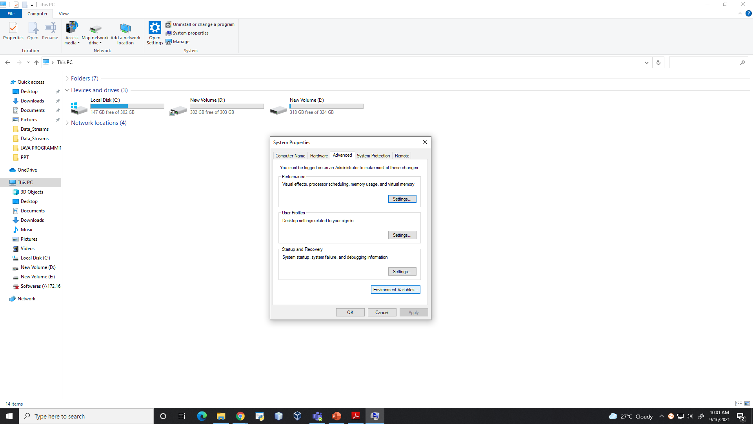

Slide 74
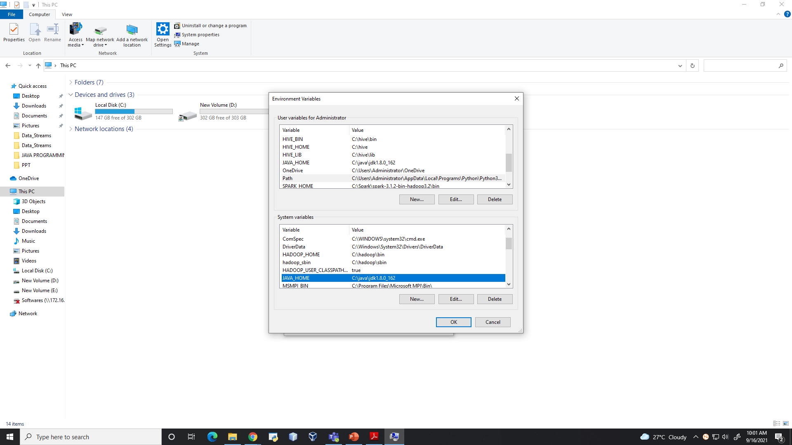

Slide 75
Access Modifier in Java

Slide 76
Access Modifier in java
As the name suggests access modifiers in Java helps to restrict the scope of a class, constructor, variable, method, or data member.
The access modifiers in Java specifies the accessibility or scope of a field, method, constructor, or class. We can change the access level of fields, constructors, methods, and class by applying the access modifier on it.
There are four types of access modifiers available in java.
Default – No keyword required
Private
Protected
Public

Slide 77
Private: The access level of a private modifier is only within the class. It cannot be accessed from outside the class.
Default: The access level of a default modifier is only within the package. It cannot be accessed from outside the package. If you do not specify any access level, it will be the default.
Protected: The access level of a protected modifier is within the package and outside the package through child class. If you do not make the child class, it cannot be accessed from outside the package.
Public: The access level of a public modifier is everywhere. It can be accessed from within the class, outside the class, within the package and outside the package.

Slide 78
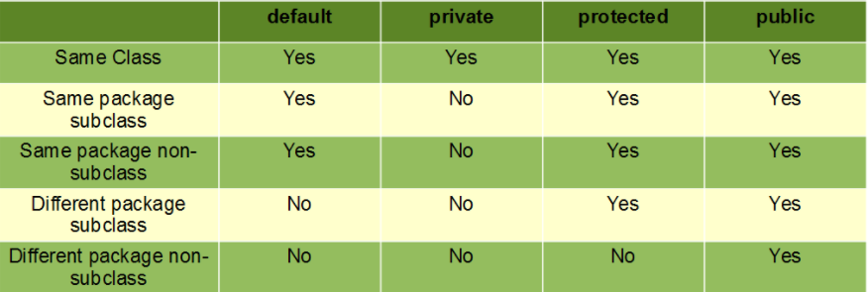

Slide 79
Private Modifier
class A{
private int data=40;
private void msg(){System.out.println("Hello java");}
}
public class Simple{
public static void main(String args[]){
A obj=new A();
System.out.println(obj.data);//Compile Time Error
obj.msg();//Compile Time Error
}
}

Slide 80
Role of Private Constructor
class A{
private A(){}//private constructor
void msg(){System.out.println("Hello java");}
}
public class Simple{
public static void main(String args[]){
A obj=new A();//Compile Time Error
}
}
If you make any class constructor private, you cannot create
the instance of that class from outside the class.

Slide 81
A class cannot be private or protected except nested class.

Slide 82
Default Modifier
The default modifier is accessible only within package. It cannot be accessed from outside the package.
It provides more accessibility than private. But, it is more restrictive than protected, and public.
//Save B.java
package mypack;
import pack.*;
class B{
public static void main(String args[])
{
A obj = new A();//Compile Time Error
obj.msg();//Compile Time Error
}
}
//Save as A.java
package pack;
class A{
void msg()
{
System.out.println("Hello");
}
}

Slide 83
Protected Modifier
The protected access modifier is accessible within package and outside the package but through inheritance only.
The protected access modifier can be applied on the data member, method and constructor. It can't be applied on the class.
//save by A.java
package pack;
public class A{
protected void msg()
{
System.out.println("Hello");}
}
//save by B.java
package mypack;
import pack.*;
class B extends A{
public static void main(String args[]){
B obj = new B();
obj.msg();
}
}

Slide 84
Public Modifier
The public access modifier is accessible everywhere. It has the widest scope among all other modifiers.
//save by A.java
package pack;
public class A{
public void msg()
{
System.out.println("Hello");}
}
//save by B.java
package mypack;
import pack.*;
class B{
public static void main(String args[]){
A obj = new A();
obj.msg();
}
}

Slide 85
Java Default Methods

Slide 86
Java Default Methods
Java provides a facility to create default methods inside the interface. Methods which are defined inside the interface and tagged with default are known as default methods. These methods are non-abstract methods.
The concept of default method is used to define a method with default implementation. You can override default method also to provide more specific implementation for the method.

Slide 87
interface Sayable{
default void say(){
System.out.println("Hello, this is default method");
}
void sayMore(String msg);
}
public class DefaultMethods implements Sayable{
public void sayMore(String msg){ // implementing abstract method
System.out.println(msg);
}
public static void main(String[] args) {
DefaultMethods dm = new DefaultMethods();
dm.say(); // calling default method
dm.sayMore("Work is worship"); // calling abstract method
}
}

Slide 88
Static Methods inside Java 8 Interface
interface Sayable{
default void say(){
System.out.println("Hello, this is default method");
}
void sayMore(String msg);
static void sayLouder(String msg){
System.out.println(msg);
}
}
public class DefaultMethods implements Sayable{
public void sayMore(String msg){ // implementing abstract method
System.out.println(msg);
}
public static void main(String[] args) {
DefaultMethods dm = new DefaultMethods();
dm.say(); // calling default method
dm.sayMore("Work is worship"); // calling abstract method
Sayable.sayLouder("Helloooo..."); // calling static method
}
}

Slide 89
Interface Variables

Slide 90
Interface Variables
The variable in an interface is public, static, and final by default.
If any variable in an interface is defined without public, static, and final keywords then, the compiler automatically adds the same.
No access modifier is allowed except the public for interface variables.
Every variable of an interface must be initialized in the interface itself.
The class that implements an interface can not modify the interface variable, but it may use as it defined in the interface.

Slide 91
Difference between default and static interface method in Java.
Default methods enable you to add new functionality to the interfaces of your libraries and ensure binary compatibility with code written for older versions of those interfaces.
A static method is a method that is associated with the class in
which it is defined rather than with any object.
Every instance of the class shares its static methods.

Slide 92
Static method in interface are part of the interface class can’t implement or override it whereas class can override the default method.

